Slide 1


Software Defined Networking (SDN)
H. Jonathan Chao
ECE Department
chao@nyu.edu

Slide 2
Outline
Limitations of Current Networks
Software Defined Networking (SDN) Concept
Why SDN?
SDN Control Plane
SDN Data Plane
SDN Use Cases

Slide 3
1. Limitations of Current Networks

Slide 4
















Limitations of Current Networks
Old ways to configure a network
App
App
App
Operating
System
Specialized Packet Forwarding Hardware
App
App
App
Operating
System
App
App
App
Specialized Packet Forwarding Hardware
Operating
System
App
App
App
Specialized Packet Forwarding Hardware
Operating
System
Specialized Packet Forwarding Hardware
App
App
App
Operating
System
Specialized Packet Forwarding Hardware
OpenFlow/SDN tutorial, Srini Seetharaman, Deutsche Telekom, Silicon Valley Innovation Center

Slide 5

Limitations of Current Networks
Feature
Feature
Many complex functions baked into infrastructure
OSPF, BGP, multicast, differentiated services, Traffic Engineering, NAT, firewalls, …
Million of lines of source code
Operating
System
Specialized Packet Forwarding Hardware
Billions of gates
Cannot dynamically change according to network conditions
OpenFlow/SDN tutorial, Srini Seetharaman, Deutsche Telekom, Silicon Valley Innovation Center

Slide 6
Limitations of Current Networks
Networks are difficult to manage
Many switches / service
Manual management and configuration of individual elements
Man power required for network maintenance
Complexity of automated configuration to deal with non-standard vendor configuration APIs
New control requirements have arisen
Greater scale
Migration of virtual machines (VMs)
Chain of middleboxes for various policies
Current equipment and protocols have limitations
Little support for monitoring and operations
Optimized for “eventual consistency” in routing
Little baseline support for low latency routing and fast failover
How to easily manage huge networks?
Need observability (global network view) and controllability (per flow routing)
SDN achieves these capabilities
Notes:
validate responsiveness as demand varies according to user needs
firewalls and load balancers
eliminate vulnerability and exposure between users and applications

Slide 7
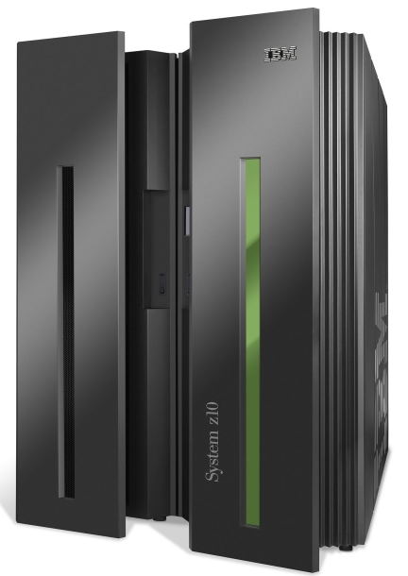
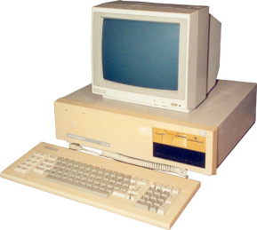
Computer System
App
App
App
App
App
App
App
App
App
App
App
Specialized
Applications
Open Interface
Windows
(OS)
Linux
Mac
OS
Specialized
Operating
System
or
or
Open Interface
Specialized
Hardware
Microprocessor
Vertically integrated
Closed, proprietary
Slow innovation
Small industry
Horizontal
Open interfaces
Rapid innovation
Huge industry

Slide 8
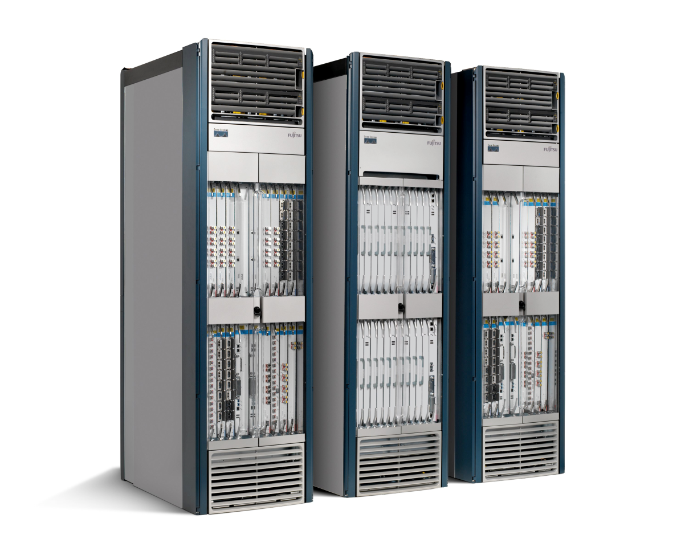
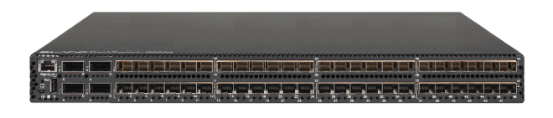
Network System
App
App
App
App
App
App
App
App
App
App
App
Specialized
Features
Open Interface
Control
Plane
Control
Plane
Control
Plane
or
or
Specialized
Control
Plane
Open Interface
Specialized
Hardware
Merchant
Switching Chips
Vertically integrated
Closed, proprietary
Slow innovation
Horizontal
Open interfaces
Rapid innovation

Slide 9
2. What is Software Defined Networking (SDN)?

Slide 10
Idea: An OS for Networks
Closed
App
App
App
Operating
System
Specialized Packet Forwarding Hardware
App
App
App
Operating
System
App
App
App
Specialized Packet Forwarding Hardware
Operating
System
App
App
App
Specialized Packet Forwarding Hardware
Operating
System
Specialized Packet Forwarding Hardware
App
App
App
Operating
System
Specialized Packet Forwarding Hardware
OpenFlow/SDN tutorial, Srini Seetharaman, Deutsche Telekom, Silicon Valley Innovation Center

Slide 11















Idea: An OS for Networks
Control Programs
Network Operating System
App
App
App
Operating
System
Specialized Packet Forwarding Hardware
App
App
App
Operating
System
App
App
App
Specialized Packet Forwarding Hardware
Operating
System
App
App
App
Specialized Packet Forwarding Hardware
Operating
System
Specialized Packet Forwarding Hardware
App
App
App
Operating
System
Specialized Packet Forwarding Hardware
OpenFlow/SDN tutorial, Srini Seetharaman, Deutsche Telekom, Silicon Valley Innovation Center
Notes:
How do we redefine the architecture to open up networking infrastructure and the industry!
By bring to the networking industry what we did to the computing world

Slide 12
Idea: An OS for Networks
Control Programs
Network Operating System
Simple Packet Forwarding Hardware
Simple Packet Forwarding Hardware
Simple Packet Forwarding Hardware
Simple Packet Forwarding Hardware
Simple Packet Forwarding Hardware
OpenFlow/SDN tutorial, Srini Seetharaman, Deutsche Telekom, Silicon Valley Innovation Center
Notes:
The key is to have a standardized control interface that speaks directly to hardware
A whole network is like a big machine

Slide 13
Idea: An OS for Networks
“NOX: Towards an Operating System for Networks”
Software-Defined Networking (SDN)
Control Programs
Global Network View
Network Operating System
Control via forwarding
interface
Protocols
Protocols
The Future of Networking, and the Past of Protocols, Scott Shenker, with Martin Casado, Teemu Koponen, Nick McKeown
Notes:
A remote controller has control of a switch’s forwarding decisions

Slide 14
3. Why SDN?

Slide 15
Network-layer functions
forwarding: move packets from router’s input to appropriate router output
data plane
routing: determine route taken by packets from source to destination
control plane
Two approaches to structuring network control plane:
per-router control (traditional)
logically centralized control (software defined networking)
For the rest of slides, most are from “Computer Networking: A Top-Down Approach” “8th edition, Jim Kurose, Keith Ross, Chapters 4& 5, http://gaia.cs.umass.edu/kurose_ross/ppt.htm

Slide 16

Per-router control plane
Individual routing algorithm components in each and every router interact in the control plane
Routing
Algorithm
control
plane
data
plane
values in arriving
packet header
0111
1
3
2

Slide 17
Software-Defined Networking (SDN) control plane
Remote controller computes, installs forwarding tables in routers
Remote Controller
control
plane
data
plane
CA
CA
CA
CA
CA
Control Agent
values in arriving
packet header
0111
1
3
2

Slide 18
Software defined networking (SDN)
Internet network layer: historically implemented via distributed, per-router control approach:
monolithic router contains switching hardware, runs proprietary implementation of Internet standard protocols (IP, RIP, IS-IS, OSPF, BGP) in proprietary router OS (e.g., Cisco IOS)
different “middleboxes” for different network layer functions: firewalls, load balancers, NAT boxes, ..
~2005: renewed interest in rethinking network control plane

Slide 19
















Middleboxes everywhere!
Firewalls, IDS: corporate, institutional, service providers, ISPs
national or global ISP
NAT: home, cellular, institutional
Load balancers: corporate, service provider, data center, mobile nets
Application-specific: service providers, institutional, CDN
datacenter
network
Caches: service provider, mobile, CDNs
enterprise
network

Slide 20
Middleboxes
initially: proprietary (closed) hardware solutions
move towards “whitebox” hardware implementing open API
move away from proprietary hardware solutions
programmable local actions via match+action
move towards innovation/differentiation in software
SDN: (logically) centralized control and configuration management often in private/public cloud
network functions virtualization (NFV): programmable services over white box networking, computation, storage

Slide 21
Middleboxes
A middlebox or network appliance is a computer networking device that transforms, inspects, filters, or otherwise manipulates traffic for purposes other than packet forwarding. Common examples of middleboxes include firewalls, which filter unwanted or malicious traffic, and network address translators (NAT), which modify packets' source and destination addresses.
Dedicated middlebox hardware is widely deployed in enterprise networks to improve network security and performance, however, even home network routers often have integrated firewall, NAT, or other middlebox functionality.
In enterprise networks, hardware modules enforce policies on flows
Higher throughput in comparison to software
Modifying every end host to enforce policies is not scalable and it lacks flexibility
But, where to place middleboxes?
https://en.wikipedia.org/wiki/Middlebox

Slide 22
Types of Middleboxes
Firewalls filter traffic based on a set of pre-defined security rules defined by a network administrator. IP firewalls reject packets "based purely on fields in the IP and Transport headers (e.g. disallow incoming traffic to certain port numbers, disallow any traffic to certain subnets etc.)" Other types of firewalls may use more complex rulesets, including those that inspect traffic at the session or application layer.
Intrusion Detection Systems monitor traffic and collect data for offline analysis for security anomalies. Because IDSs unlike firewalls do not filter packets in real-time, they traditionally are capable of more complex inspection than firewalls which must make an accept/reject decision about each packet as it arrives.
Network Address Translators replace the source and/or destination IP addresses of packets that traverse them. Typically, NATs are deployed to allow multiple end hosts to share a single IP address: hosts "behind" the NAT are assigned a private IP address and their packets destined to the public Internet traverse a NAT which replaces their internal, private address with a shared public address.
WAN Optimizers improve bandwidth consumption and perceived latency between dedicated endpoints. Typically deployed in large enterprises, WAN optimizers are deployed near both sending and receiving endpoints of communication; the devices then co-ordinate to cache and compress traffic that traverses the Internet.
Load balancers provide one point of entry to a service, but forward traffic flows to one or more hosts that actually provide the service.
https://en.wikipedia.org/wiki/Middlebox

Slide 23
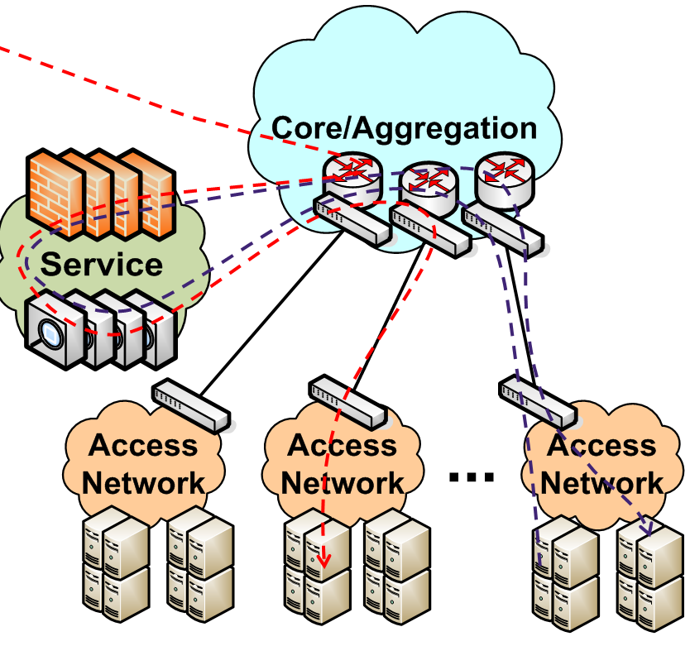
Chaining Middleboxes in a Data Center
Packets pass through middleboxes (firewall, network address translator, load balancer) before reaching the destination
chaining of various middleboxes – needs to be flexible, agile, and fast configuration
Internet traffic
Datacenter
Middleboxes

Slide 24
Software defined networking (SDN)
Why a logically centralized control plane?
easier network management: avoid router misconfigurations, greater flexibility of traffic flows
table-based forwarding allows “programming” routers
centralized “programming” easier: compute tables centrally and distribute
distributed “programming” more difficult: compute tables as result of distributed algorithm (protocol) implemented in each-and-every router
open (non-proprietary) implementation of control plane
foster innovation: let 1000 flowers bloom

Slide 25

Traffic engineering: difficult with traditional routing
5
3
v
w
5
2
u
2
1
z
3
1
2
x
y
1
Q: what if network operator wants u-to-z traffic to flow along uvwz, rather than uxyz?
A: need to re-define link weights so traffic routing algorithm computes routes accordingly (or need a new routing algorithm)!
link weights are only control “knobs”: not much control!

Slide 26
Traffic engineering: difficult with traditional routing
5
3
v
w
5
2
u
2
1
z
3
1
2
x
y
1
Q: what if network operator wants to split u-to-z traffic along uvwz and uxyz (load balancing)?
A: can’t do it (or need a new routing algorithm)

Slide 27
Traffic engineering: difficult with traditional routing
5
3
v
w
5
2
u
2
1
z
3
1
2
x
y
1
Q: what if w wants to route blue and red traffic differently from w to z?
A: can’t do it (with destination-based forwarding, and LS, DV routing)
We learned in Chapter 4 that generalized forwarding and SDN can be used to achieve any routing desired

Slide 28
Software defined networking (SDN)
…
3. control plane functions external to data-plane switches
4. programmable control applications
routing
access control
load
balance
Remote Controller
control
plane
data
plane
CA
2. control, data plane separation
CA
CA
CA
CA
1: generalized “flow-based” forwarding (e.g., OpenFlow)

Slide 29
4. SDN Control Plane

Slide 30
Software defined networking (SDN)
Data-plane switches:
fast, simple, commodity switches implementing generalized data-plane forwarding in hardware
flow (forwarding) table computed, installed under controller supervision
API for table-based switch control (e.g., OpenFlow)
defines what is controllable, what is not
protocol for communicating with controller (e.g., OpenFlow)
network-control applications
…
routing
access
control
load
balance
control
plane
northbound API
SDN Controller
(network operating system)
southbound API
data
plane
SDN-controlled switches

Slide 31
Software defined networking (SDN)
SDN controller (network OS):
maintain network state information
interacts with network control applications “above” via northbound API
interacts with network switches “below” via southbound API
implemented as distributed system for performance, scalability, fault-tolerance, robustness
network-control applications
…
routing
access
control
load
balance
control
plane
northbound API
SDN Controller
(network operating system)
southbound API
data
plane
SDN-controlled switches

Slide 32
Software defined networking (SDN)
network-control apps:
“brains” of control: implement control functions using lower-level services, API provided by SDN controller
unbundled: can be provided by 3rd party: distinct from routing vendor, or SDN controller
network-control applications
…
routing
access
control
load
balance
control
plane
northbound API
SDN Controller
(network operating system)
southbound API
data
plane
SDN-controlled switches

Slide 33
Components of SDN controller
routing
access
control
load
balance
interface layer to network control apps: abstractions API
Interface, abstractions for network control apps
…
network graph
RESTful
API
intent
…
network-wide state management : state of networks links, switches, services: a distributed database
statistics
flow tables
SDN
controller
Network-wide distributed, robust state management
…
Link-state info
host info
switch info
…
communication: communicate between SDN controller and controlled switches
OpenFlow
SNMP
Communication to/from controlled devices

Slide 34
SDN Controller
SDN controllers of a datacenter provide policy and centralized managements for the Openstack Neutron networking layer that provides inter-working between the virtual ports created by Nova.
Nova, an OpenStack project, provides a way to provision VMs.
Historical SDN controllers for managing the programmable switches of the network.
SDN controllers is to manage the Linux kernel features made of L3 IP routing, Linux bridges, iptables or ebtables, network namespaces and Open vSwitch.
Open and community driven initiatives the following SDN controllers: Open Daylight (controller baseline project upon which many other controllers are built), ONOS, Project Calico, The Fast Data Project, Project Floodlight, Beacon, NOX/POX, Open vSwitch, vneio/sdnc (SDN Controller from vne.io), Ryu Controller (supported by NTT Labs), Cherry, Faucet (Python based on Ryu for production networks), OpenContrail
https://en.wikipedia.org/wiki/List_of_SDN_controller_software

Slide 35
SDN Controller - Ryu
Ryu Controller is an open, software-defined networking (SDN) Controller designed to increase the agility of the network by making it easy to manage and adapt how traffic is handled. In general, the SDN Controller is the brains of the SDN environment, communicating information down to the switches and routers with southbound APIs, and up to the applications and business logic with northbound APIs. The Ryu Controller is supported by NTT and is deployed in NTT cloud data centers as well.
The Ryu Controller provides software components, with well-defined application program interfaces (APIs), that make it easy for developers to create new network management and control applications. This component approach helps organizations customize deployments to meet their specific needs; developers can quickly and easily modify existing components or implement their own to ensure the underlying network can meet the changing demands of their applications.
https://www.sdxcentral.com/sdn/definitions/sdn-controllers/open-source-sdn-controllers/what-is-ryu-controller/

Slide 36
The Ryu Controller source code is hosted on GitHub and managed and maintained by the open Ryu community. OpenStack, which runs an open collaboration focused on developing a cloud operating system that can control the compute, storage and networking resources of an organization, supports deployments of Ryu as the network Controller.
Written entirely in Python, all of Ryu’s code is available under the Apache 2.0 license and open for anyone to use. The Ryu Controller supports NETCONF and OF-config network management protocols, as well as OpenFlow, which is one of the first and most widely deployed SDN communications standards.
The Ryu Controller can use OpenFlow to interact with the forwarding plane (switches and routers) to modify how the network will handle traffic flows. It has been tested and certified to work with a number of OpenFlow switches, including Open vSwitch and offerings from Centec, Hewlett Packard, IBM, and NEC.
https://www.sdxcentral.com/sdn/definitions/sdn-controllers/open-source-sdn-controllers/what-is-ryu-controller/

Slide 37

OpenFlow protocol
operates between controller, switch
TCP used to exchange messages
optional encryption
three classes of OpenFlow messages:
controller-to-switch
asynchronous (switch to controller)
symmetric (misc.)
distinct from OpenFlow API
API used to specify generalized forwarding actions
OpenFlow Controller

Slide 38
OpenFlow: controller-to-switch messages
Key controller-to-switch messages:
features: controller queries switch features, switch replies
configure: controller queries/sets switch configuration parameters
modify-state: add, delete, modify flow entries in the OpenFlow tables
packet-out: a message used by the controller to send out a specific packet out of a specific switch port
OpenFlow Controller

Slide 39
OpenFlow: switch-to-controller messages
Key switch-to-controller messages
packet-in: a not-matched packet sent to controller for further processing (e.g., routing), or a matched packet in some cases
flow-removed: flow table entry deleted at switch
port status: inform controller of a change on a port.
OpenFlow Controller
Fortunately, network operators don’t “program” switches by creating/sending OpenFlow messages directly. Instead use higher-level abstraction at controller

Slide 40
OpenFlow Messages
Asynchronous (Controller-to-Switch)
Send-packet: to send packet out of a specific port on a switch
Flow-mod: to add/delete/modify flows in the flow table
Asynchronous (initiated by the controller)
Read-state: to collect statistics about flow table, ports and individual flows
Features: sent by controller when a switch connects to find out the features supported by a switch
Configuration: to set and query configuration parameters in the switch
Asynchronous (initiated by the switch)
Packet-in: for all packets that do not have a matching rule, this event is sent to controller
Flow-removed: whenever a flow rule expires, the controller is sent a flow-removed message
Port-status: whenever a port configuration or state changes, a message is sent to controller
Error: error messages
Symmetric (can be sent in either direction without solicitation)
Hello: at connection startup
Echo: to indicate latency, bandwidth or liveliness of a controller-switch connection
Vendor: for extensions (that can be included in later OpenFlow versions)
Theophilus Benson, CPS 590: Software Defined Networking, https://www.cs.duke.edu/courses/fall14/compsci590.4/notes/F14_Class1.pptx

Slide 41
SDN: control/data plane interaction example
Dijkstra’s link-state
routing
1
S1, experiencing link failure to S2 uses OpenFlow port status message to notify controller
4
…
network graph
RESTful
API
intent
3
…
2
SDN controller receives OpenFlow message, updates link status info
statistics
flow tables
…
Link-state info
host info
switch info
3
2
Dijkstra’s routing algorithm application has previously registered to be called when ever link status changes. It is called.
…
OpenFlow
SNMP
1
4
Dijkstra’s routing algorithm access network graph info, link state info in controller, computes new routes
s2
s1
s4
s3

Slide 42
SDN: control/data plane interaction example
Dijkstra’s link-state
routing
4
5
…
network graph
RESTful
API
intent
5
link state routing app interacts with flow-table-computation component in SDN controller, which computes new flow tables needed
3
…
statistics
flow tables
…
Link-state info
host info
switch info
2
…
OpenFlow
SNMP
6
controller uses OpenFlow to install new tables in switches that need updating
S1 will now route packets destined to S2 via S4
1
6
s2
s1
s4
s3

Slide 43
5. SDN Data Plane

Slide 44
Generalized forwarding: match plus action
Review: each router contains a forwarding table
“match plus action” abstraction: match bits in arriving packet, take action
(aka: flow table)
destination-based forwarding: forward based on dest. IP address
values in arriving
packet header
generalized forwarding:
many header fields can determine action
many action possible: drop/copy/modify/log packet
0111
1
3
2
forwarding table
(aka: flow table)

Slide 45
Flow table abstraction
flow: defined by header field values (in link-, network-, transport-layer fields)
generalized forwarding: simple packet-handling rules
match: pattern values in packet header fields
actions: for matched packet: drop, forward, modify, matched packet or send matched packet to controller
priority: disambiguate overlapping patterns
counters: #bytes and #packets
Flow table
Router’s flow table define router’s match+action rules
match
action

Slide 46
Flow table abstraction
flow: defined by header fields
generalized forwarding: simple packet-handling rules
match: pattern values in packet header fields
actions: for matched packet: drop, forward, modify, matched packet or send matched packet to controller
priority: disambiguate overlapping patterns
counters: #bytes and #packets
src = *.*.*.*, dest=3.4.*.* forward(2)
Flow table
match
action
src=1.2.*.*, dest=*.*.*.* drop
src=10.1.2.3, dest=*.*.*.* send to controller
* : wildcard
1
4
3
2

Slide 47




OpenFlow Usage
Alice’s code:
Simple learning switch
Per Flow switching
Network access control/firewall
Static “VLANs”
Her own new routing protocol: unicast, multicast, multipath
Home network manager
Packet processor (in controller)
IPvAlice
Controller
Alice’s Rule
Alice’s code
OpenFlow Switch
PC
Decision?
OpenFlow
Protocol
Alice’s Rule
Alice’s Rule
OpenFlow Switch
OpenFlow Switch
OpenFlow/SDN tutorial, Srini Seetharaman, Deutsche Telekom, Silicon Valley Innovation Center
Notes:
Table entries can be updated

Slide 48

OpenFlow facilitates SDN
Applications
Applications
Applications
Controller(NOS)
OpenFlow
OpenFlow
Southbound
API
Switch O.S
Switch O.S
Switch H.W
Switch H.W
Theophilus Benson, CPS 590: Software Defined Networking, https://www.cs.duke.edu/courses/fall14/compsci590.4/notes/F14_Class1.pptx

Slide 49
OpenFlow
OpenFlow Controller
OpenFlow Protocol (SSL/TCP)
Switch/Router
Control Path
OpenFlow
Data Path (Hardware)
OpenFlow/SDN tutorial, Srini Seetharaman, Deutsche Telekom, Silicon Valley Innovation Center
Notes:
Leverages hardware inside most switches today (ACL tables)

Slide 50

Controller
Switch/Router
OpenFlow Client
PC
Software
Layer
TCAM
OpenFlow Table
MAC
src
MAC
dst
IP
Src
IP
Dst
TCP
sport
TCP
dport
Action
TCAM: Ternary Content
Addressable Memory
Hardware
Layer
*
*
*
5.6.7.8
*
*
port 1
Switch
port 1
port 2
port 3
port 4
5.6.7.8
1.2.3.4
The Stanford Clean Slate Program, http://cleanslate.stanford.edu

Slide 51
OpenFlow: flow table entries
Match
Action
Stats
Packet + byte counters
Forward packet to port(s)
Drop packet
Modify fields in header(s)
Encapsulate and forward to controller
Header fields to match:
Ingress Port
Src MAC
Dst MAC
Eth Type
VLAN
ID
VLAN
Pri
IP Src
IP Dst
IP Proto
IP
ToS
TCP/UDP Src Port
TCP/UDP Dst Port
Link layer
Network layer
Transport layer

Slide 52
OpenFlow: examples
Destination-based forwarding:
Switch
Port
MAC
src
MAC
dst
Eth
type
VLAN
ID
VLAN
Pri
IP
Src
IP
Dst
IP
Prot
IP
ToS
TCP
s-port
TCP
d-port
Action
*
*
*
*
*
*
*
51.6.0.8
*
*
*
*
port6
IP datagrams destined to IP address 51.6.0.8 should be forwarded to router output port 6
Firewall:
Switch
Port
MAC
src
MAC
dst
Eth
type
VLAN
ID
VLAN
Pri
IP
Src
IP
Dst
IP
Prot
IP
ToS
TCP
s-port
TCP
d-port
Action
*
*
*
*
*
*
*
*
*
*
*
22
drop
Block (do not forward) all datagrams destined to TCP port 22 (ssh port #)
Switch
Port
MAC
src
MAC
dst
Eth
type
VLAN
ID
VLAN
Pri
IP
Src
IP
Dst
IP
Prot
IP
ToS
TCP
s-port
TCP
d-port
Action
*
*
*
*
*
*
128.119.1.1
*
*
*
*
*
drop
Block (do not forward) all datagrams sent by host 128.119.1.1

Slide 53
OpenFlow: examples
Layer 2 destination-based forwarding:
Switch
Port
MAC
src
MAC
dst
Eth
type
VLAN
ID
VLAN
Pri
IP
Src
IP
Dst
IP
Prot
IP
ToS
TCP
s-port
TCP
d-port
Action
*
*
22:A7:23:
11:E1:02
*
*
*
*
*
*
*
*
*
port3
layer 2 frames with destination MAC address 22:A7:23:11:E1:02 should be forwarded to output port 3

Slide 54
OpenFlow abstraction
match+action: abstraction unifies different kinds of devices
Router
match: longest destination IP prefix
action: forward out a link
Switch
match: destination MAC address
action: forward or flood
Firewall
match: IP addresses and TCP/UDP port numbers
action: permit or deny
NAT
match: IP address and port
action: rewrite address and port

Slide 55
Generalized forwarding: summary
“match plus action” abstraction: match bits in arriving packet header(s) in any layers, take action
matching over many fields (link-, network-, transport-layer)
local actions: drop, forward, modify, or send matched packet to controller
“program” network-wide behaviors
simple form of “network programmability”
programmable, per-packet “processing”
historical roots: active networking
today: more generalized programming:
P4 (see p4.org).

Slide 56
6. SDN Use Cases

Slide 57

OpenFlow example
Orchestrated tables can create network-wide behavior, e.g.,:
datagrams from hosts h5 and h6 should be sent to h3 or h4, via s1 and from there to s2
Host h6
10.3.0.6
1
s3
controller
2
3
4
Host h5
10.3.0.5
1
s1
s2
Host h1
10.1.0.1
1
2
Host h4
10.2.0.4
4
2
4
3
3
Host h2
10.1.0.2
Host h3
10.2.0.3

Slide 58
OpenFlow example
match
action
Orchestrated tables can create network-wide behavior, e.g.,:
datagrams from hosts h5 and h6 should be sent to h3 or h4, via s1 and from there to s2
IP Src = 10.3.*.*
IP Dst = 10.2.*.*
Host h6
10.3.0.6
forward(3)
1
s3
controller
2
3
4
Host h5
10.3.0.5
1
s1
s2
Host h1
10.1.0.1
1
2
Host h4
10.2.0.4
4
2
4
3
3
match
action
match
action
Host h2
10.1.0.2
Host h3
10.2.0.3
ingress port = 2
IP Dst = 10.2.0.3
ingress port = 2
IP Dst = 10.2.0.4
ingress port = 1
IP Src = 10.3.*.*
IP Dst = 10.2.*.*
forward(3)
forward(4)
forward(4)

Slide 59
SDN: selected challenges
hardening the control plane: dependable, reliable, performance-scalable, secure distributed system
robustness to failures: leverage strong theory of reliable distributed system for control plane
dependability, security: “baked in” from day one?
networks, protocols meeting mission-specific requirements
e.g., real-time, ultra-reliable, ultra-secure
Internet-scaling: beyond a single Autonomous System (AS)
SDN critical in 5G cellular networks

Slide 60
Data-Plane Limitations
Limited Number of TCAM entries
Currently only 1K
Networks have more than 1K flows
How to fit network in limited entries?
Limited control channel capacity
All switches use the same controller interface
Need to rate limit control messages
Prioritize certain messages
Limited switch CPU
Less power than a smartphone ☹
Limit control messages and actions that use CPU
Applications
Applications
Applications
Controller (N. O.S.)
O.S
Switch H.W
Theophilus Benson, CPS 590: Software Defined Networking, https://www.cs.duke.edu/courses/fall14/compsci590.4/notes/F14_Class1.pptx

Slide 61
Debugging SDNs
Buggy
App
Problems can occur anywhere in the SDN stack
How do you diagnose each type of problem?
Applications
Applications
Applications
Network O.S.
Buggy
NOS
Buggy
Switch
S/W
Buggy
Switch
H/W
Switch Operating System
Switch Operating System
Switch Hardware
Switch Hardware
Theophilus Benson, CPS 590: Software Defined Networking, https://www.cs.duke.edu/courses/fall14/compsci590.4/notes/F14_Class1.pptx

Slide 62

SDN and the future of traditional network protocols
SDN-computed versus router-computer forwarding tables:
just one example of logically-centralized-computed versus protocol computed
one could imagine SDN-computed congestion control:
controller sets sender rates based on router-reported (to controller) congestion levels
How will implementation of network functionality (SDN versus protocols) evolve?

Slide 63
Conclusions
What is SDN and Why?
A system-layered abstraction
Programmable, flexible, and extensible
What is OpenFlow?
Interface between switches and controllers
Enabling SDN
SDN is here for real-world use
Enables rapid rich feature deployment
Simplifies network management

